Slide 1

Bias and Fairness in
Information Filtering Systems
Registration Seminar Abhisek Dash
17CS91R01
Supervised by
Dr. Saptarshi Ghosh
Dr. Animesh Mukherjee

Slide 2
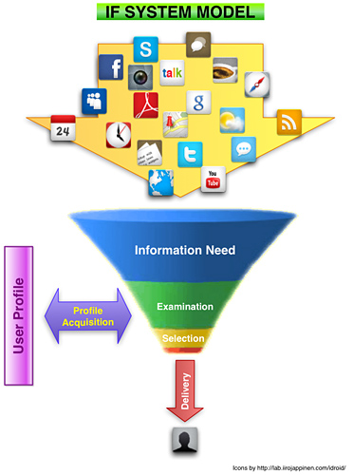
Information Filtering Systems
A system for monitoring large amount of dynamically generated information and pushing to a user a subset of information likely to be of his/her interest (based on his/her information needs).
Belkin, Nicholas J., and W. Bruce Croft. "Information filtering and information retrieval: Two sides of the same coin?." Communications of the ACM 35.12 (1992): 29-38.

Slide 3

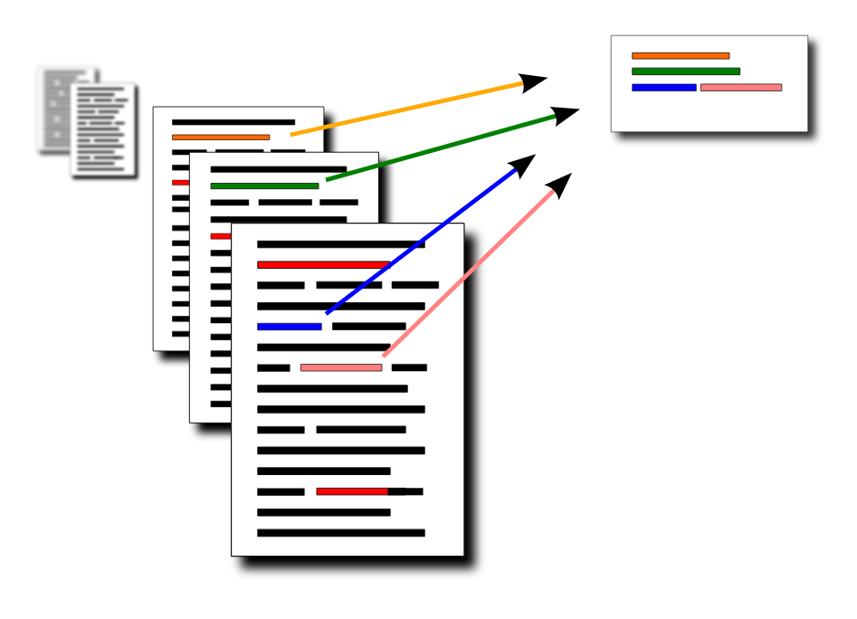

Search systems
INFORMATION FILTERING
SYSTEMS
Recommendation
systems
Summarization
systems

Slide 4
PRIMARY STAKEHOLDERS
CONTENT GENERATOR
(PRODUCERS)
PLATFORM
IF SYSTEMS
CONSUMERS
(USERS)

Slide 5
Search systems
Relevance
(NDCG, HR)
INFORMATION FILTERING
SYSTEMS
Recommendation
systems
Summarization
systems
Relevance / Relatedness
(NDCG, HR)
Summary quality
(ROUGE)

Slide 6
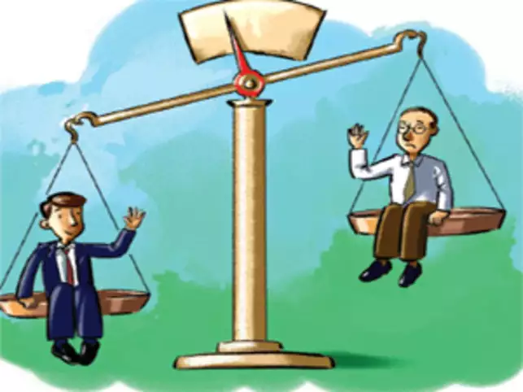
Inadvertent consequences
Discrimination / bias / under representation
[1] Kulshrestha, Juhi, et al. "Quantifying search bias: Investigating sources of bias for political searches in social media." ACM CSCW 2017
[2] Mehrotra, Rishabh, et al. "Auditing search engines for differential satisfaction across demographics." WWW 2017

Slide 7

Inadvertent consequences
Discrimination / bias / under representation
Information segregation
[1] Pariser, Eli. The filter bubble: What the Internet is hiding from you. Penguin UK, 2011.
[2] Chakraborty, Abhijnan, et al. "On quantifying knowledge segregation in society." FATREC workshop, RecSys 2017.

Slide 8
Inadvertent consequences
Discrimination / bias
Information segregation
HOW CAN WE ACCOUNT FOR THESE IN THE EXISTING (DEPLOYED) SYSTEMS?

Slide 9
Need of the hour
Existing IF Systems
Discovery of the inadvertent consequences
Mitigation of the inadvertent consequences

Slide 10
Need of the hour
Existing IF Systems
Algorithmic Auditing
Modification in the existing pipeline

Slide 11
Our contributions
Existing IF Systems
Algorithmic Auditing
Summarization
Recommendation
Modification in the existing pipeline
Summarization

Slide 12
PART I
Motivation and Methods for Fairness in Algorithmic Summaries
-PACMHCI 2019 (ACM CSCW 2019)

Slide 13
Generic text summarization framework
Summary
Generation
Document
Summary
Summarization
Algorithm

Slide 14

Generic text summarization framework
Summary
Generation
Document
Summary
Summarization
Algorithm
ROUGE
Scores
Summary
Evaluation
Evaluation
Human
Annotators
Gold Standard
Summaries

Slide 15
Generic text summarization framework
Summary
Generation
Document
Summary
Objective- Maximize summary quality
Summarization
Algorithm
ROUGE
Scores
Summary
Evaluation
Evaluation
Human
Annotators
Gold Standard
Summaries

Slide 16
Heterogenous online content
Pro-republican
Pro-democrat
Neutral
Users’ posts
Summary
Summarization
Algorithm

Slide 17
Heterogenous online content
What should be the color of the summary?
Pro-republican
Pro-democrat
Neutral
Users’ posts
Summary
?
Summarization
Algorithm

Slide 18
Why does color of the summary matter?
Users’ posts
Summary 1
Summarization
Algorithm 1

Slide 19
Why does color of the summary matter?
Users’ posts
Summary 1
Summarization
Algorithm 1
Summarization
Algorithm 2
Summary 2

Slide 20


Why does color of the summary matter?
Users’ posts
Summary 1
Summarization
Algorithm 1
Summarization
Algorithm 2
Summary 2

Slide 21
Why does color of the summary matter?
Users’ posts
Summary 1
Posts in the summary get high exposure
Summarization
Algorithm 1
Summarization
Algorithm 2
Summary 2

Slide 22
Two questions
Do the tweets written by different social groups reflect different opinions?
Are the tweets written by different social groups of comparable textual quality?

Slide 23
Two questions
Do the tweets written by different social groups reflect different opinions? YES
Are the tweets written by different social groups of comparable textual quality?

Slide 24
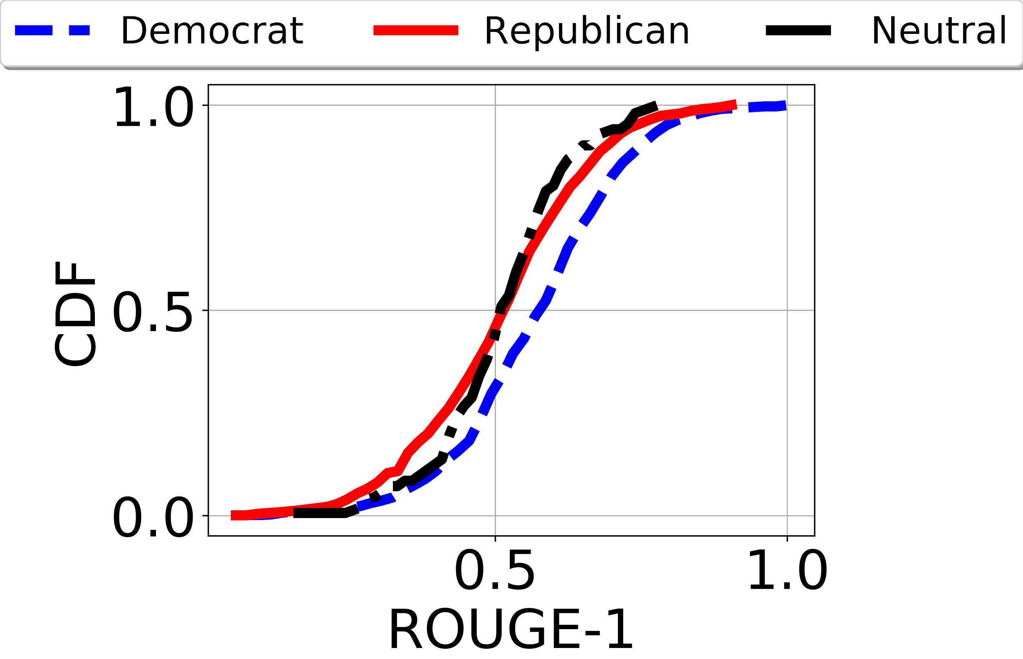
How to measure textual quality?
ROUGE-1 of a tweet: fraction of unigrams of the tweet present in gold standard summaries ([0, 1])

Slide 25
How to measure textual quality?
ROUGE-1 of a tweet: fraction of unigrams of the tweet present in gold standard summaries ([0, 1])
The distributions are very similar.

Slide 26
How to measure textual quality?
ROUGE-1 of a tweet: fraction of unigrams of the tweet present in gold standard summaries ([0, 1])
The distributions are very similar.
Averages of ROUGE-1 in each class are similar.

Slide 27
Two questions
Do the tweets written by different social groups reflect different opinions? YES
Are the tweets written by different social groups of comparable textual quality? YES

Slide 28
What should be the color of the summary?
Users’ posts
Summary 1
Summarization
Algorithm 1
Summarization
Algorithm 2
Summary 2

Slide 29
What should be the color of the summary?
Users’ posts
Summary 1
Existing summarization algorithms do not attempt to control the color (fairness) of the summary
Summarization
Algorithm 1
Summarization
Algorithm 2
Summary 2

Slide 30
We propose to include an additional control
Fairness notion
Users’ posts
Summary
Summarization
Algorithm

Slide 31
Proportional Representation
Proportional Representation
Users’ posts
Summary
Summarization
Algorithm

Slide 32
Equal Representation
Equal Representation
Users’ posts
Summary
Summarization
Algorithm

Slide 33
Our framework
Fairness notion
Users’ posts
Summary
Summarization
Algorithm
ROUGE
Scores
Evaluation
Human
Annotators
Gold Standard
Summaries

Slide 34
Our framework
Fairness notion
Users’ posts
Summary
Two objectives
Maximize summary quality
(2) Adhere to fairness constraints
Summarization
Algorithm
ROUGE
Scores
Evaluation
Human
Annotators
Gold Standard
Summaries

Slide 35
Do existing algorithms produce fair summaries?

Slide 36
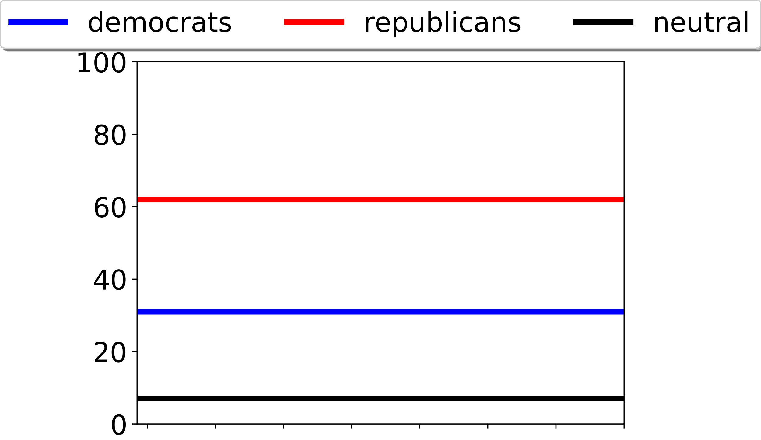
A sample dataset
Distributions in input text
pro-republican = 62 %
pro-democrat = 31 %
neutral = 7 %
62 %
31 %
07 %

Slide 37
A sample dataset
Distributions in input text
pro-republican = 62 %
pro-democrat = 31 %
neutral = 7 %
62 %
31 %
07 %
Does existing algorithms conform to Proportional Fairness?

Slide 38
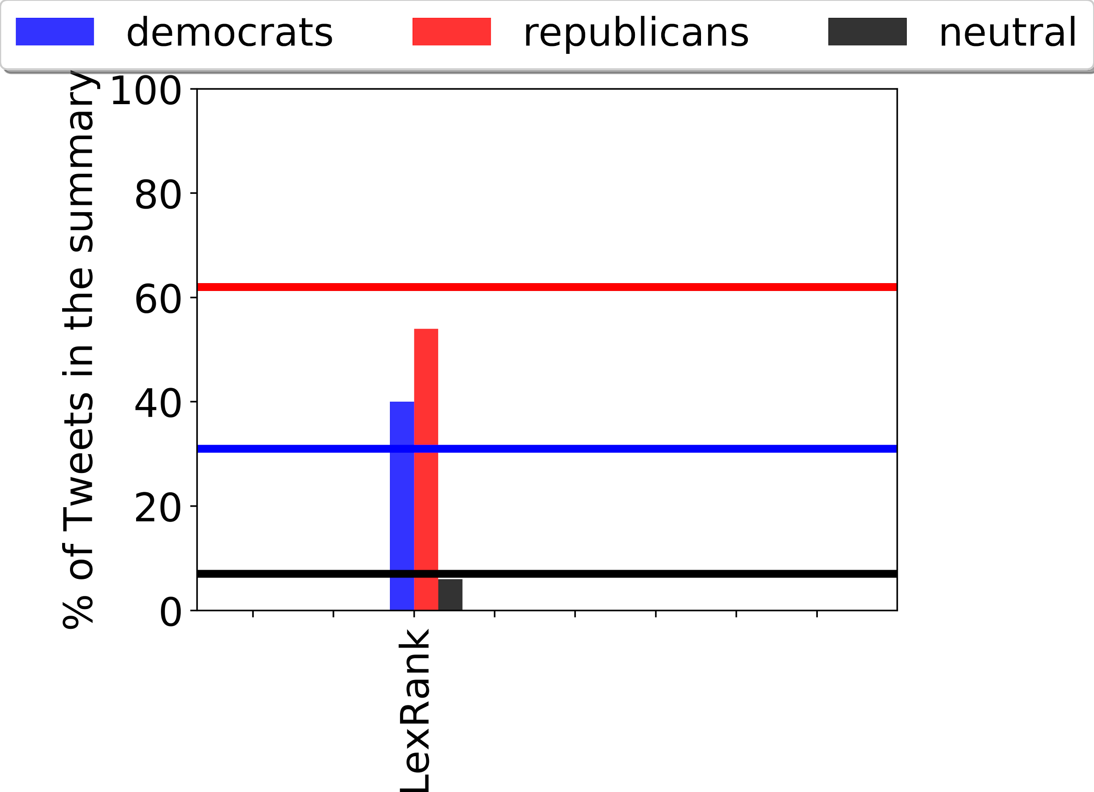
Using an existing algorithm: LexRank
62 %
In summary produced by LexRank
pro-democrat tweets over-represented
pro-republicans and neutrals are under-represented
31 %
07 %

Slide 39
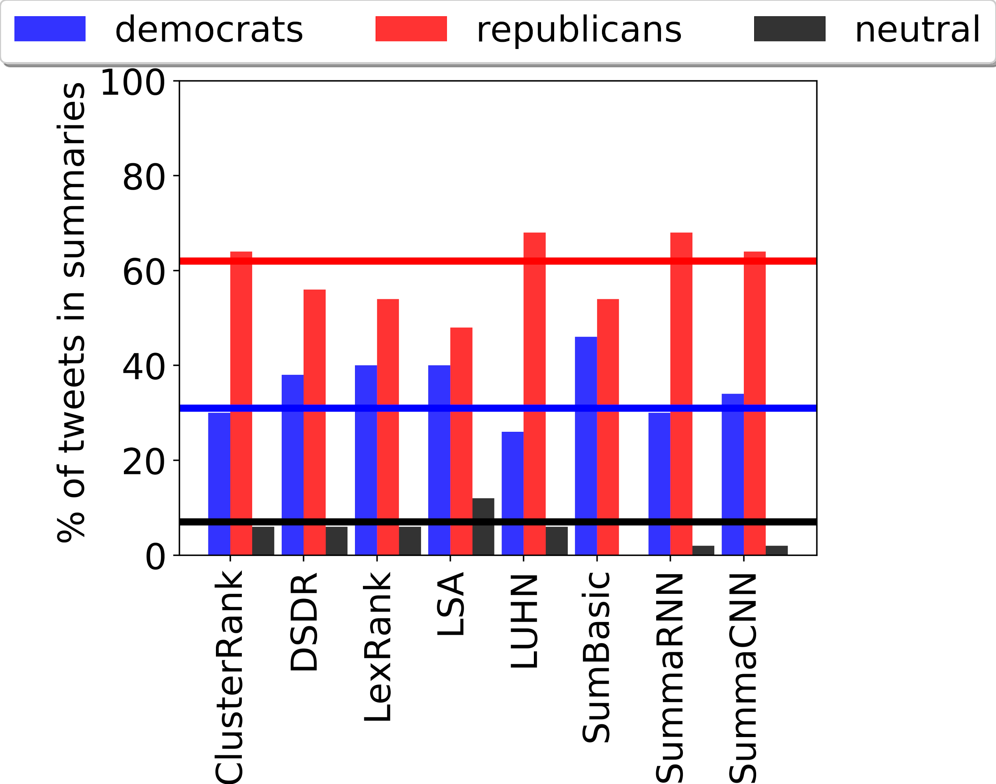
We analyzed eight summarization algorithms
62 %
Most of the algorithms under-represent tweets from at least 2 groups
Similar behavior on different datasets
31 %
07 %

Slide 40
We analyzed eight summarization algorithms
Existing summarization algorithms do not produce fair summaries
(according to standard fairness notions)
62 %
Most of the algorithms under-represent tweets from at least 2 groups
Similar behavior on different datasets
31 %
07 %

Slide 41
How to achieve fairness in summarization?

Slide 42
Standard algorithmic pipeline
Input
Algorithm
Output

Slide 43
Pre-processing based algorithm
Input
Algorithm
Output
ClasswiseSumm

Slide 44
In-processing based algorithm
Input
Algorithm
Output
ClasswiseSumm
FairSumm
Our primary contribution

Slide 45
Post-processing based algorithm
Input
Algorithm
Output
ClasswiseSumm
FairSumm
Our primary contribution
ReFaSumm

Slide 46
Pre-processing based algorithm
Input
Algorithm
Output
ClasswiseSumm

Slide 47
ClasswiseSumm
Textual units
. . .
Split the tweets as per their groups.
Group 1
Group n

Slide 48
ClasswiseSumm
Textual units
. . .
Split the tweets as per their groups.
Summarize each group individually.
Group 1
Group n
. . .
Algorithm
Algorithm
. . .
Summary 1
Summary n

Slide 49
ClasswiseSumm
Textual units
. . .
Split the tweets as per their groups.
Summarize each group individually.
Combine the summaries to generate the final summary.
Group 1
Group n
. . .
Algorithm
Algorithm
. . .
Summary 1
Summary n
Summary

Slide 50
In-processing based algorithm
Input
Algorithm
Output
FairSumm
Our primary contribution

Slide 51
FairSumm
Two important aspects of a good summary
Coverage: amount of information covered (L(S)) should be high
Diversity: avoid redundancy or reward diverse information (R(S))

Slide 52
FairSumm
Two important aspects of a good summary
Coverage: amount of information covered (L(S)) should be high
Diversity: avoid redundancy or reward diverse information (R(S))
Maximize, Ƒ(S) = ƛ₁ * L(S) + ƛ₂ * R(S)
Monotonic non-decreasing submodular function

Slide 53
FairSumm
Two important aspects of a good summary
Coverage: amount of information covered (L(S)) should be high
Diversity: avoid redundancy or reward diverse information (R(S))
Maximize, Ƒ(S) = ƛ₁ * L(S) + ƛ₂ * R(S)
Subjected to the fairness constraint
Summary S should satisfy the underlying notion of fairness.
Constrained monotonic non-decreasing submodular function

Slide 54
FairSumm
Two important aspects of a good summary
Coverage: amount of information covered (L(S)) should be high
Diversity: avoid redundancy or reward diverse information (R(S))
Maximize, Ƒ(S) = ƛ₁ * L(S) + ƛ₂ * R(S)
Subjected to the fairness constraint
Summary S should satisfy the underlying notion of fairness.
We solve the above by algorithm proposed by Du et al. to get the final summary. [1]
Constrained monotonic non-decreasing submodular function
[1] Du, MFB Nan, Yingyu Liang, and L. Song. "Continuous-time influence maximization for multiple items." CoRR, abs/1312.2164 (2013).

Slide 55
How good are our fair summarization algorithms?

Slide 56
Datasets*
Claritin: opinions of male & female users on a drug Claritin
Gender
US-Election: pro-dem, pro-rep and neutral tweets on US Presidential election 2016
Political leaning
MeToo: opinions of male & female users on MeToo movement
Gender
* Available at https://github.com/ad93/FairSumm

Slide 57
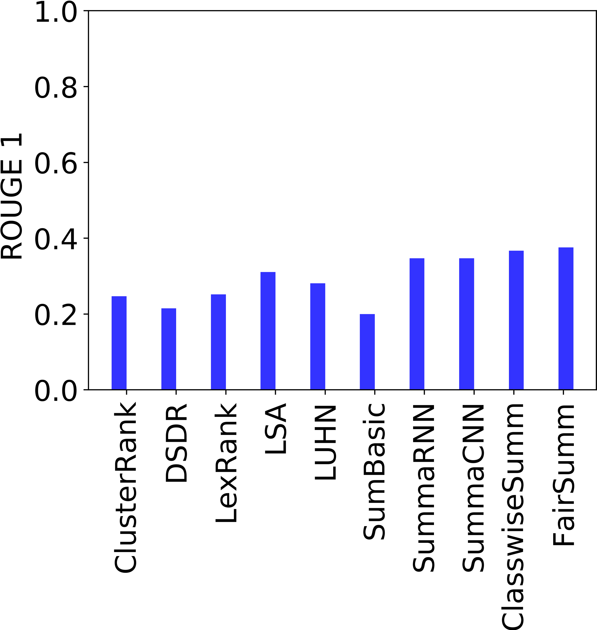
How good are the summaries produced by our algorithms?

Slide 58
How good are the summaries produced by our algorithms?
FairSumm and ClasswiseSumm are as good as the state-of-the-art algorithms.

Slide 59
How good are the summaries produced by our algorithms?
Introducing fairness does not compromise on summary quality
FairSumm and ClasswiseSumm are as good as the state-of-the-art algorithms.

Slide 60
Discussion and future work
What are acceptable notions of fairness in the context of summarization?
Who decides the notion of fairness — consumer / producer / platform?
Fairness w.r.t. Demographics, or fairness w.r.t. Opinions?

Slide 61
Fairness w.r.t demographics or w.r.t. opinions?
Distribution of opinions demographic distribution.

Slide 62
Fairness w.r.t demographics or w.r.t. opinions?
Distribution of opinions demographic distribution.
Perspective based or aspect based summarizations^{[1]} might be the way ahead.
[1] Rudra, Koustav, et al. "Identifying sub-events and summarizing disaster-related information from microblogs." ACM SIGIR 2018

Slide 63
PART II
Framework for Auditing Recommendation Systems
-IEEE INFOCOM 2019

Slide 64
Recommendation systems
Recommendations are ubiquitous on web.
Nudge users to make certain choices.
Reason for financial benefits to user satisfaction.

Slide 65
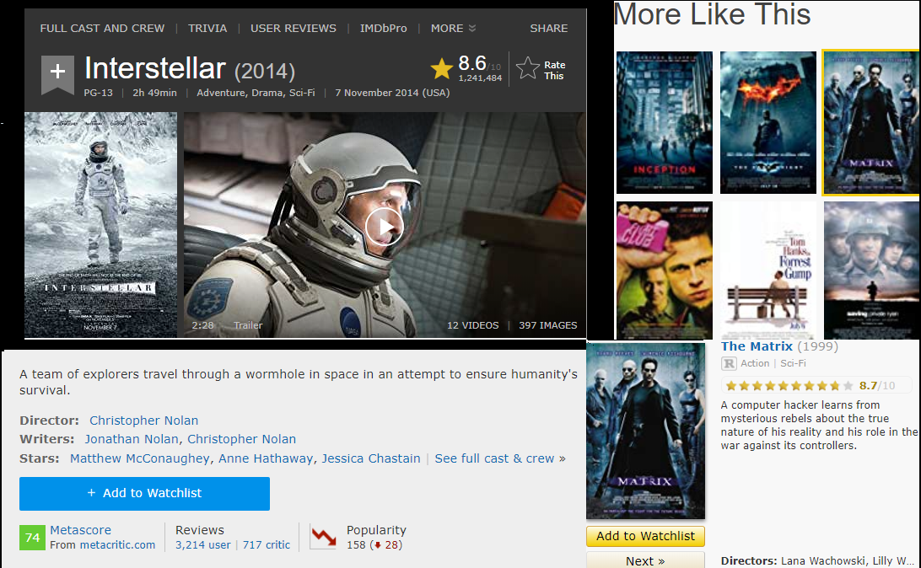

Slide 66
Recommendation systems
Recommendations are ubiquitous on web.
Nudge users to make certain choices.
Reason for financial benefits to user satisfaction.

Slide 67
Recommendation systems
Recommendations are ubiquitous on web.
Nudge users to make certain choices.
Reason for financial benefits to user satisfaction.

Slide 68
Do we know how are we recommended?

Slide 69

How are we recommended?
Probably NO
Algorithmic details are unknown.
User-item interactions are unknown.

Slide 70
Inadvertent consequences
Filter Bubble
Information Segregation

Slide 71
Potential solution
Algorithmic auditing is a research design that has shown promise in diagnosing the unwanted consequences of algorithmic systems.
Sandvig, Christian, et al. "Auditing algorithms: Research methods for detecting discrimination on internet platforms." Data and discrimination: converting critical concerns into productive inquiry 22 (2014).

Slide 72
Algorithmic auditing
Why is it the need of the hour?
Prerequisites for auditing
Issues for a third-party auditor

Slide 73
Algorithmic auditing
Why is it the need of the hour?
Prerequisites for auditing
Algorithm
Domain of the algorithm
User-item interactions
Issues for a third-party auditor

Slide 74
Algorithmic auditing
Why is it the need of the hour?
Prerequisites for auditing
Issues for a third-party auditor (outside the organization)
Unavailability of the algorithms
Unavailability of the user-item interactions

Slide 75
Algorithmic auditing
Why is it the need of the hour?
Prerequisites for an auditor
Issues for a third party auditor
RQ: How does a third party audit a recommendation system without having all the prerequisites?

Slide 76
Our contributions
A Network- framework for third party auditing of Recommendation Systems.
Useful applications of the framework to explore
Information Segregation
due to the intervention of such systems.

Slide 77
Framework for auditing recommendation systems
A directed (un)weighted network,
Each node is an item.
Directed edge i j, means j is recommended on the page of i.
We name this network as a “Related Item Network (RIN)”.

Slide 78
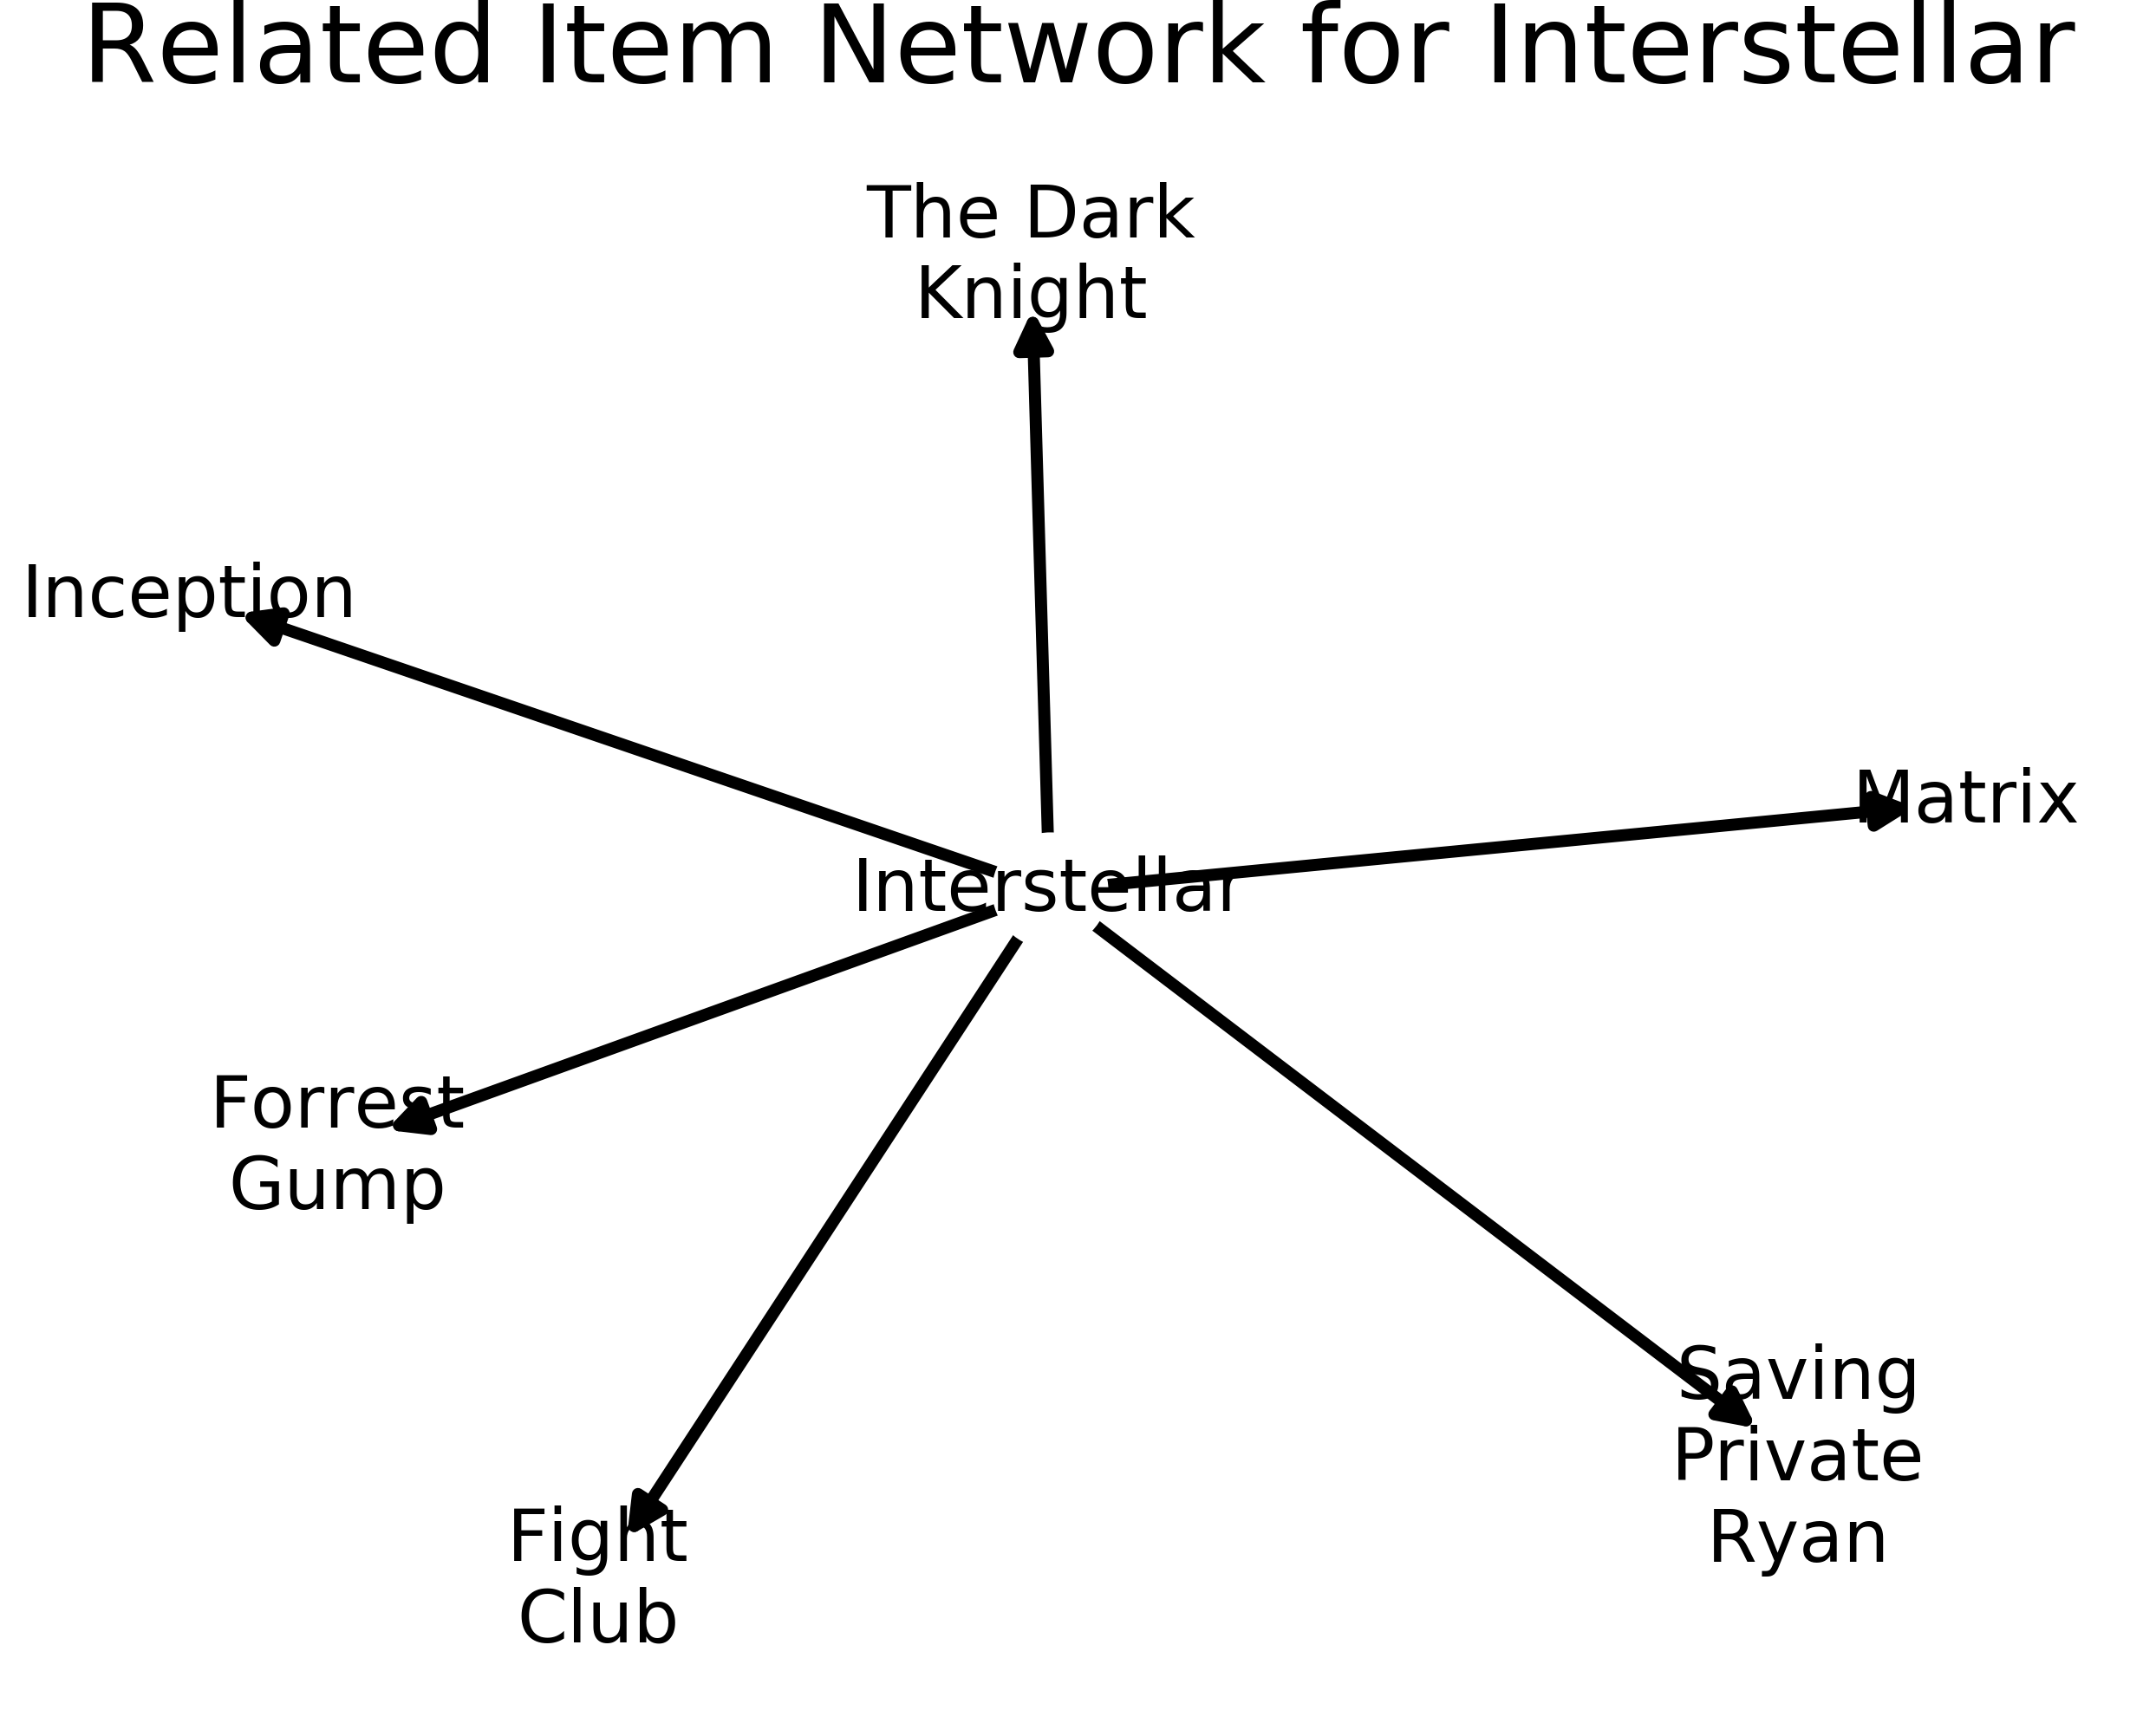
Related Item Network (RIN)
‹#›

Slide 79
Features of Related Item Network
Different from item-item similarity graph.
All edges can be weighted
Sim(i, j)
Rank of j in the recommendation list of i.
User browsing can be modelled as random walks.

Slide 80
User browsing on related item networks (RINs)

Slide 81
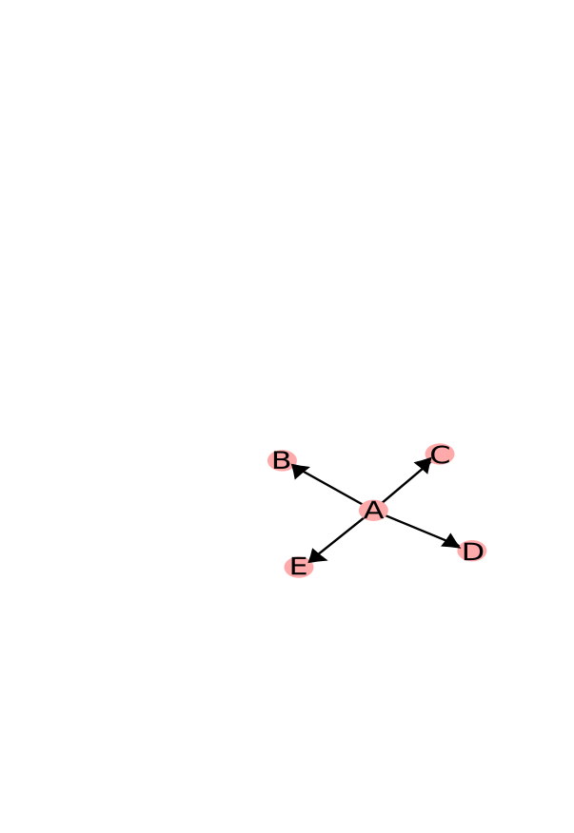

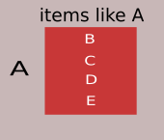
RANDOM USER
RECOMMENDATIONS ON WEB_PAGE OF A
Corresponding RIN

Slide 82

Let me watch movie A

Slide 83
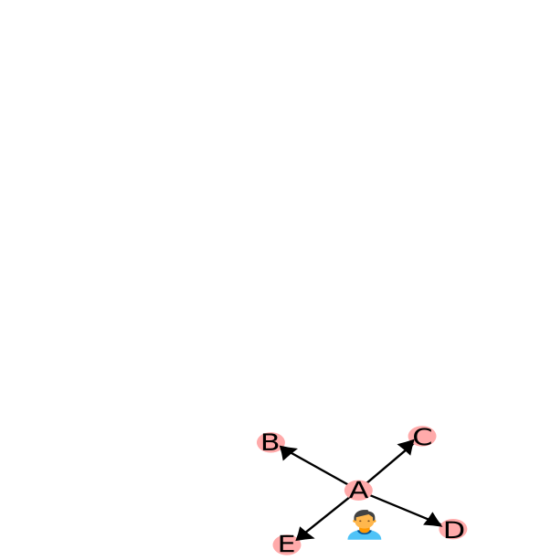
Let me watch movie A

Slide 84
Let me watch movie A

Slide 85
Let me watch movie A
Nice!!! Let me watch another movie !!!

Slide 86
Let me watch movie A
Nice!!! Let me watch another movie !!!
Aah!!! The site is already recommending me a few

Slide 87
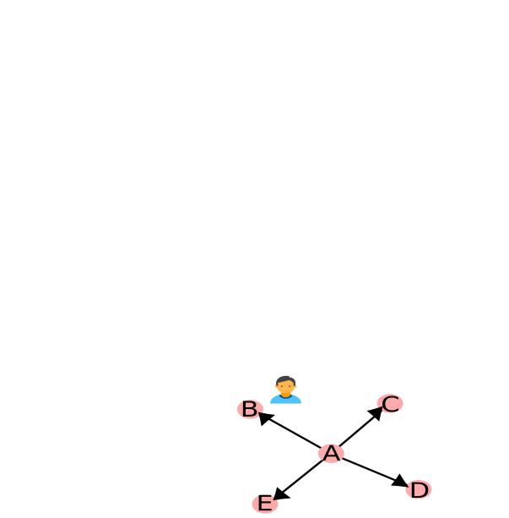
Let me watch movie A
Nice!!! Let me watch another movie !!!
Aah!!! The site is already recommending me a few

Slide 88
Let me watch movie A
Nice!!! Let me watch another movie !!!
Aah!!! The site is already recommending me a few
Observed Movie Distribution-
{A, B}

Slide 89
Let me watch movie A
Nice!!! Let me watch another movie !!!
Aah!!! The site is already recommending me a few
Observed Movie Distribution-
{A, Z}
Z

Slide 90



Data collections
Data were collected by a Breadth First Search crawler.
We seeded the crawler with an initial movie.
The recommendations were scraped.
172K
24K
2K

Slide 91
Information Segregation in Recommendation Systems

Slide 92
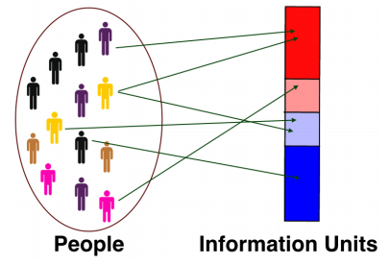
Information Segregation
It is the property of the process of opinion formation in the society.
An m-dimensional information space, where
Information units are different genres.
Each movie is an information source.
Genre1
Genre2
Genre3
Genre4
P. Dandekar, A. Goel, and D. T. Lee, “Biased assimilation, homophily, and the dynamics of polarization,” PNAS, 2013

Slide 93
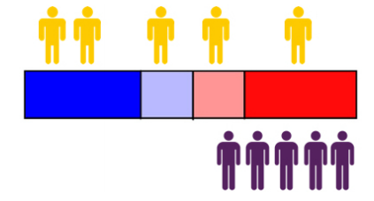
Measure for Information Segregation
Evenness: Captures how uniformly different groups are exposed to different information units.
Yellow Group
Purple Group
Yellow group is more evenly distributed than purple group.
A. Chakraborty, M. Ali, S. Ghosh, N. Ganguly, and K. P. Gummadi, “On quantifying knowledge segregation in society,” FATREC Workshop on Responsible Recommendation, 2017.

Slide 94
Experimental Setup
User browsing by random walks (stated earlier)
There are 110 groups of 10 random users each.
Groups have been created as per each random user’s
Starting movie (10 popular movies)
Propensity to follow recommendations (11 different values 0.0, 0.1, 0.2 …, 1.0)

Slide 95
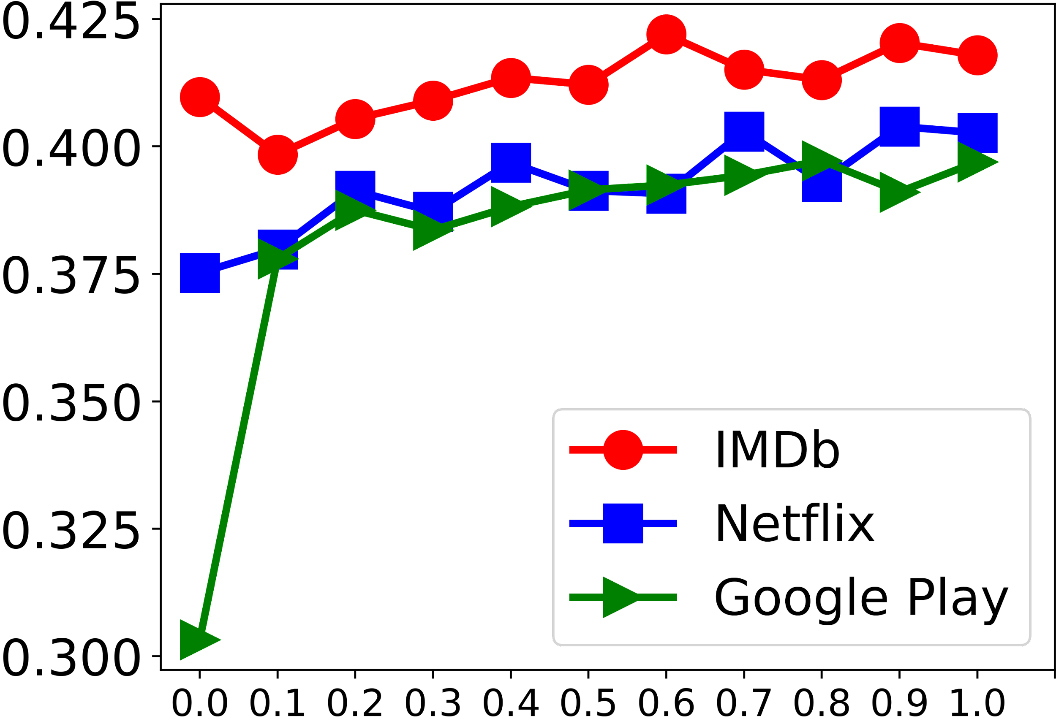
Extent of Information Segregation
Evenness of the
observed distribution
Always follow recommendations
Never follow recommendations
User propensity to follow recommendations
Evenness slowly increases with decrease in propensity to follow recommendations.
IMDb has better evenness than Netflix and Google Play.

Slide 96
Extent of Information Segregation
Alarming
Evenness of the
observed distribution
Always follow recommendations
Never follow recommendations
User propensity to follow recommendations
Evenness slowly increases with decrease in propensity to follow recommendations.
IMDb has better evenness than Netflix and Google Play.

Slide 97
Concluding Remarks
A simplistic yet useful model for third party auditing.
How likely is a recommendation system to cause information segregation?

Slide 98
Future Work
Our framework can be extended to other domains.
If enough data are available, personalization can also be incorporated.
Developing methodology to audit and mitigate for bias in the context of recommendation

Slide 99
Acknowledgements
Supervisors
Collaborators
CNeRG, IIT Kharagpur
Dept. of CSE
TCS Research

Slide 100


THANK YOU
FOR
YOUR ATTENTION!!!
https://github.com/ad93/
@AbhisekFair

Slide 101
Backup slides

Slide 102
Post-processing based algorithm
Input
Algorithm
Output
ReFaSumm

Slide 103
ReFaSumm
Summarization algorithms generate a ranked list of textual units based on their summary worthiness.

Slide 104
ReFaSumm
Summarization algorithms generate a ranked list of textual units based on their summary worthiness.
Fairly re-ranking them leads to generate fair summaries.

Slide 105
ReFaSumm
Summarization algorithms generate a ranked list of textual units based on their summary worthiness.
Fairly re-ranking them leads to generate fair summaries.
We have used the FA*IR algorithm for achieving the desired fairness criteria. [1]
[1] Zehlike, Meike, et al. "Fa* ir: A fair top-k ranking algorithm." In proc ACM CIKM 2017

Slide 106
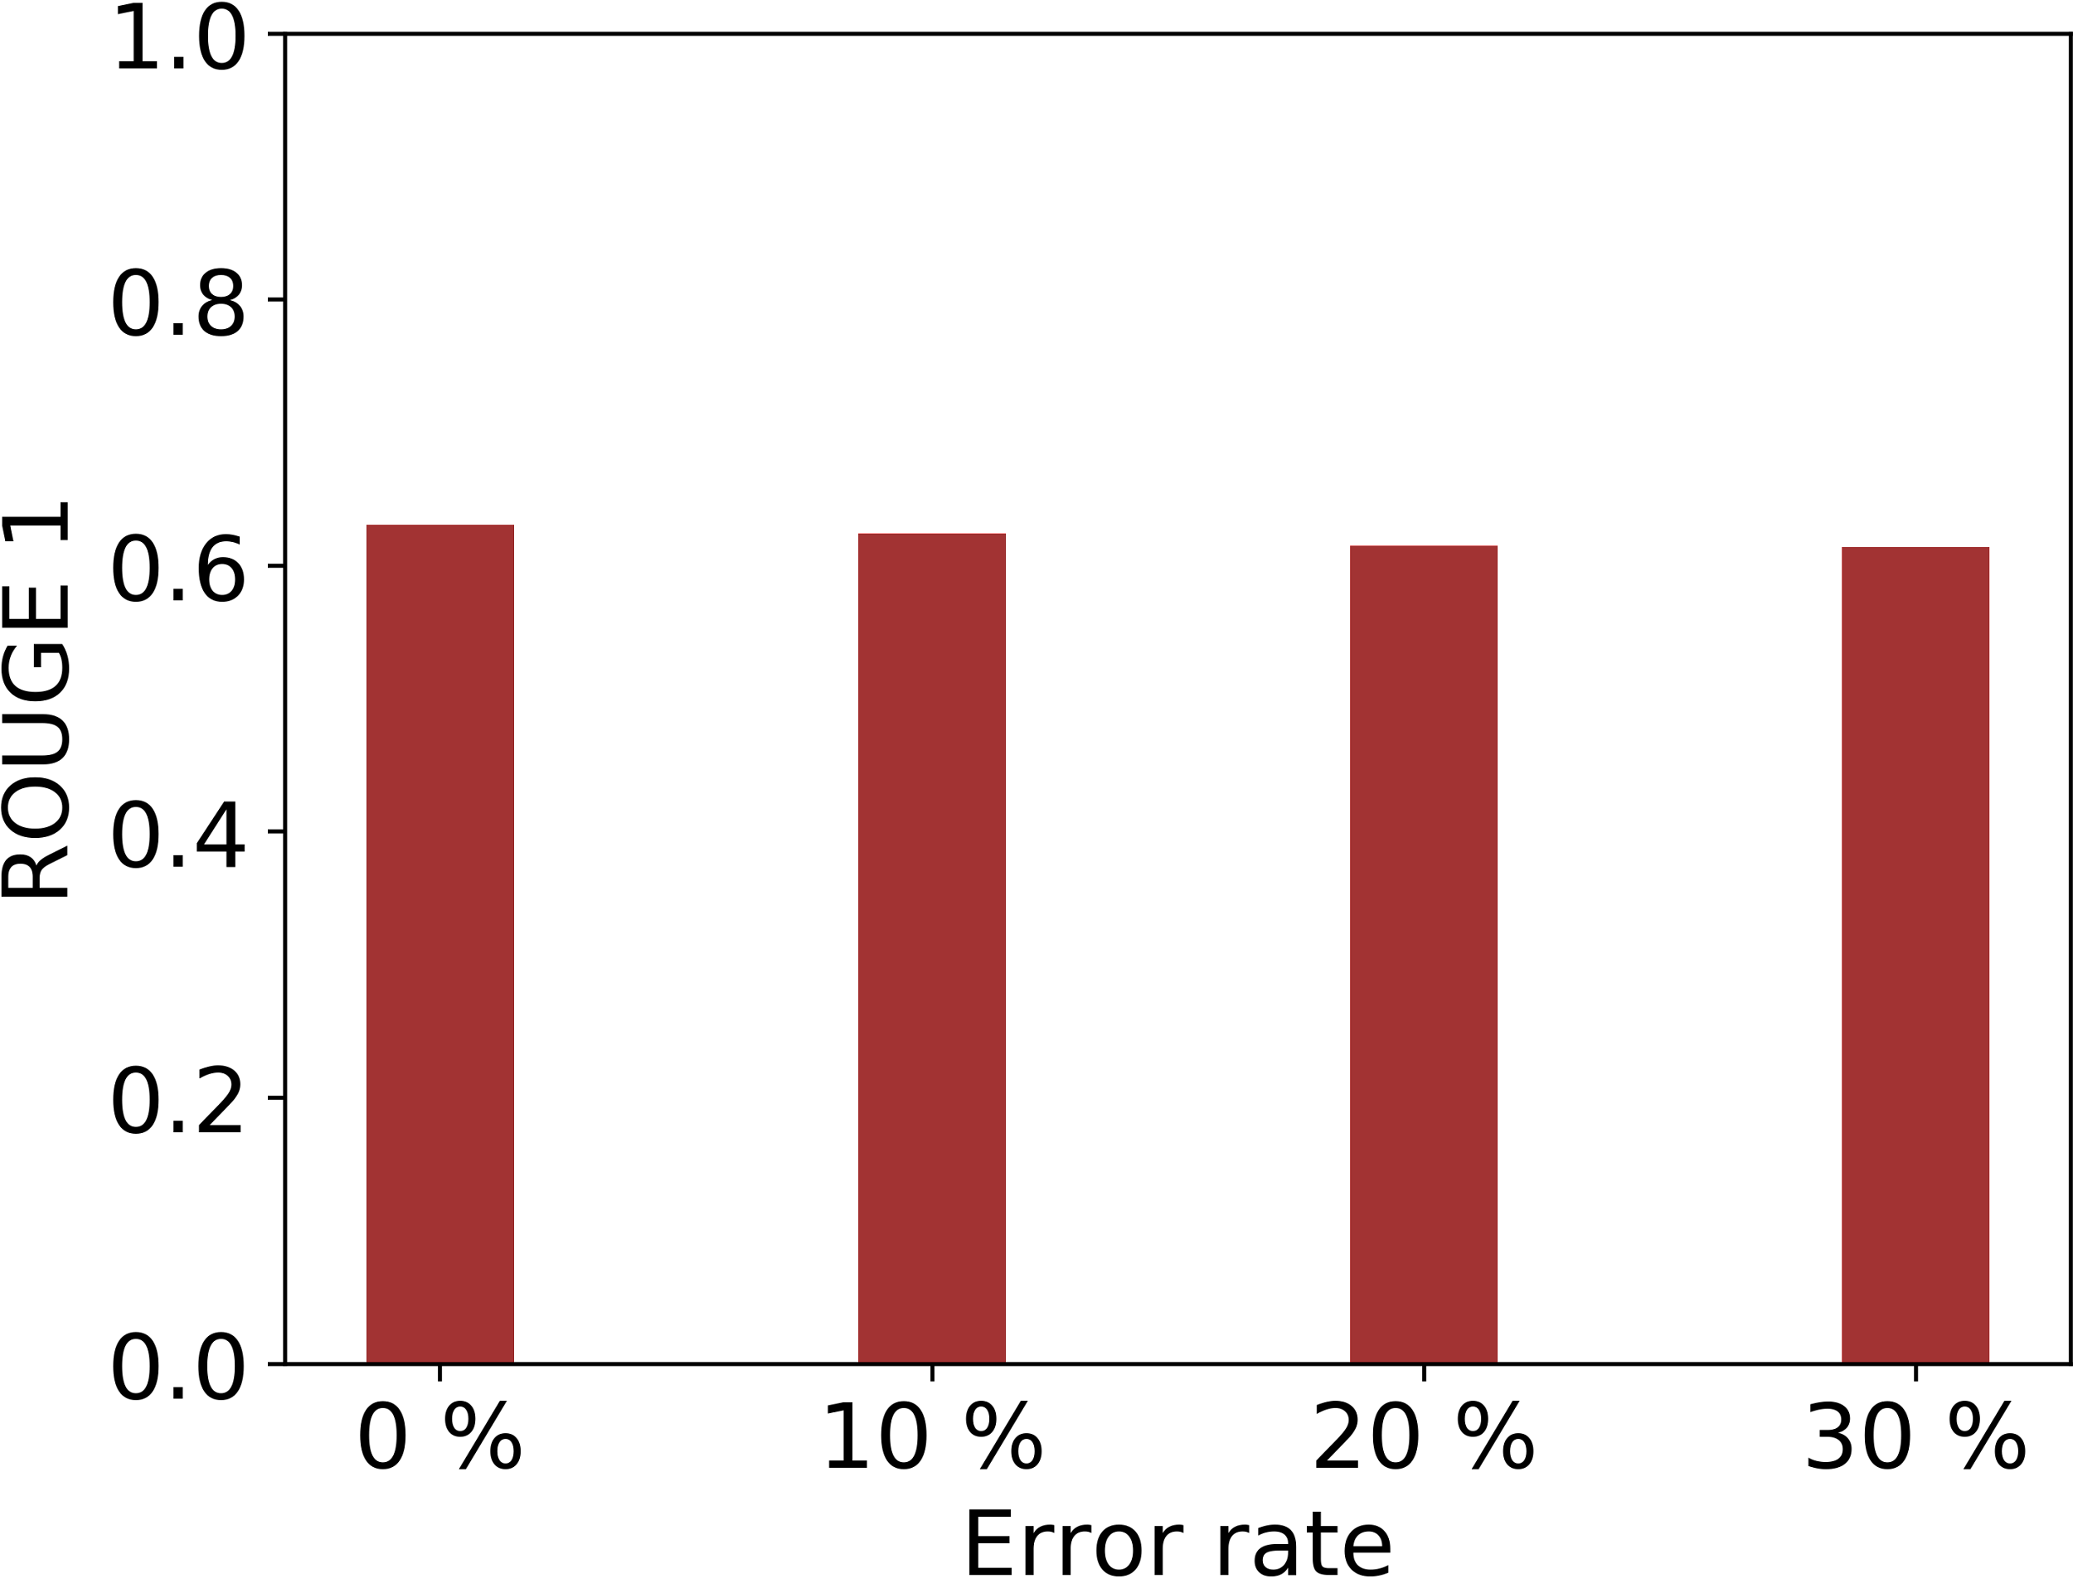
Results and insights
The proposed algorithms are immune to degraded information of demographic details.

Slide 107
Results and insights
The proposed algorithms are immune to degraded information of demographic details.
Proposed algorithms are generalizable to different fairness notions.

Slide 108
Limitations and future work
Proposed algorithms assume the availability of the class information.
Who gets to decide what is an appropriate social salient group for an application?
Fair representation in the opinion space rather than demographic space.

Slide 109
Diversity
Generally, diversity is defined as an opposite notion to similarity.
A set of similar items may not always be useful for a user.
Many macroscopic measures of diversity are well known in the literature. (e.g. intralist diversity, longtail novelty etc.)

Slide 110
Where lies the problem?
Macroscopic measures do not give a clear picture.
Diversity or lack of it may not be distributed similarly across different types of items.

Slide 111
Contingency Matrix
TYPES | TYPES
 | M | a | b | c
 | a | M_{aa} | M_{ab} | M_{ac}
 | b | M_{ba} | M_{bb} | M_{bc}
 | c | M_{ca} | M_{cb} | M_{cc}

Slide 112
Contingency Matrix
TYPES | TYPES
 | M | a | b | c
 | a | M_{aa} | M_{ab} | M_{ac}
 | b | M_{ba} | M_{bb} | M_{bc}
 | c | M_{ca} | M_{cb} | M_{cc}
Application Specific (Genre/Popularity)

Slide 113
Contingency Matrix
TYPES | TYPES
 | M | a | b | c
 | a | M_{aa} | M_{ab} | M_{ac}
 | b | M_{ba} | M_{bb} | M_{bc}
 | c | M_{ca} | M_{cb} | M_{cc}
Application Specific (Genre/Popularity)

Slide 114
Contingency Matrix
TYPES | TYPES
 | M | a | b | c
 | a | M_{aa} | M_{ab} | M_{ac}
 | b | M_{ba} | M_{bb} | M_{bc}
 | c | M_{ca} | M_{cb} | M_{cc}
Application Specific (Genre/Popularity)
Indegree of nodes suggest how often they are being recommended on the platform .

Slide 115
Contingency Matrix
TYPES | TYPES
 | M | Unpopular | Moderately popular | Popular
 | Unpopular | M_{aa} | M_{ab} | M_{ac}
 | Moderately popular | M_{ba} | M_{bb} | M_{bc}
 | Popular | M_{ca} | M_{cb} | M_{cc}
Fraction of recommendations from ‘moderately popular’ movies to ‘popular’ movies..

Slide 116
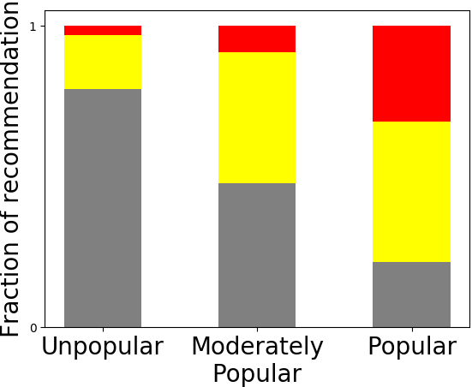
Contingency Matrix based on Popularity
IMDb Recommendation Network

Slide 117
Contingency Matrix based on Popularity
Recommendations from popular movies to popular movies
Recommendations from popular movies to moderately popular movies
Recommendations from popular movies to unpopular movies
IMDb Recommendation Network

Slide 118
Contingency Matrix based on Popularity
Most diverse
IMDb Recommendation Network

Slide 119
Contingency Matrix based on Popularity
Mostly recommends itself
Most diverse
IMDb Recommendation Network

Slide 120
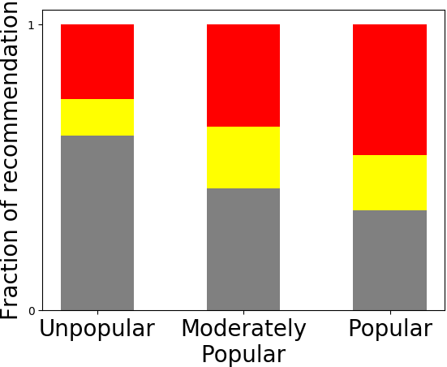
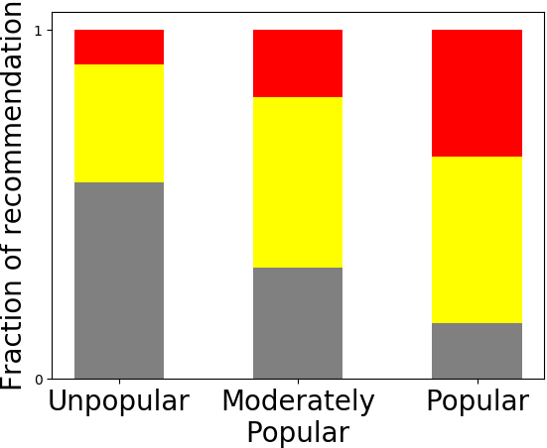
Netflix
Google Play
High level insight:
IMDb is more diverse than Netflix and Google Play.
IMDb

Slide 121
Random Walk-based Measures
Recommendation Network + User Browsing
Shannon entropy of their observed distribution to quantify the diversity.

Slide 122
Random Walk-based Measures
Recommendation Network + User Browsing
Shannon entropy of their observed distribution to quantify the diversity.
Major factor that determines diversity:
Teleportation probability (User Propensity)

Slide 123
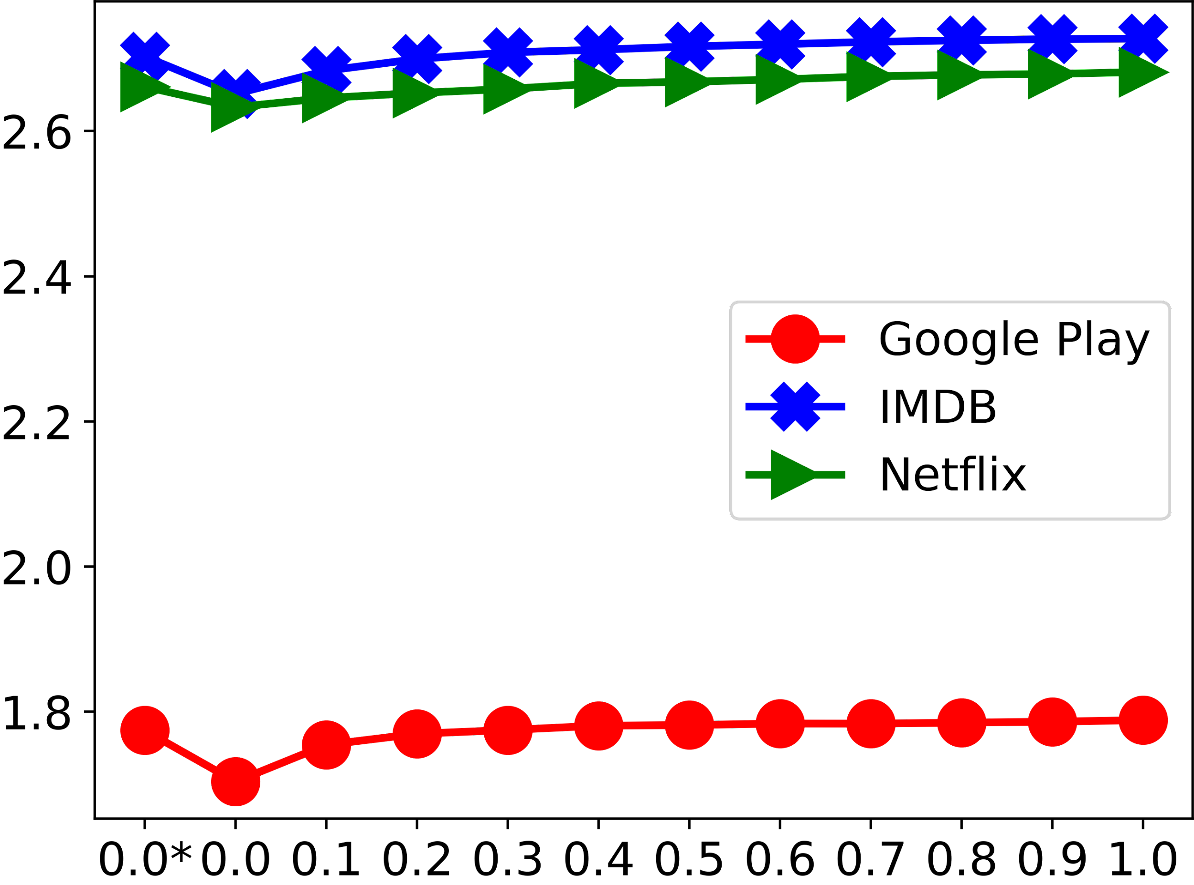
Variation of Entropy
Entropy of the
observed distribution
Always follow recommendations
User propensity to follow recommendations
Never follow recommendations

Slide 124
Variation of Entropy
High Diversity
(If the top recommendation is always followed)
Entropy of the
observed distribution
Always follow recommendations
User propensity to follow recommendations
Never follow recommendations

Slide 125
Variation of Entropy
High Diversity
(If the top recommendation is always followed)
Entropy of the
observed distribution
Lowest Diversity
Always follow recommendations
User propensity to follow recommendations
Never follow recommendations

Slide 126
Variation of Entropy
High Diversity
(If the top recommendation is always followed)
Google Play is less diverse in comparison to IMDb and Netflix
Entropy of the
observed distribution
Lowest Diversity
Always follow recommendations
User propensity to follow recommendations
Never follow recommendations

Slide 127
Information Filtering Systems
Search system

Slide 128
Information Filtering Systems
Search system
Recommendation systems

Slide 129
Information Filtering Systems
Search system
Recommendation systems
Summarization systems

Slide 130

Web as a source of information

Slide 131
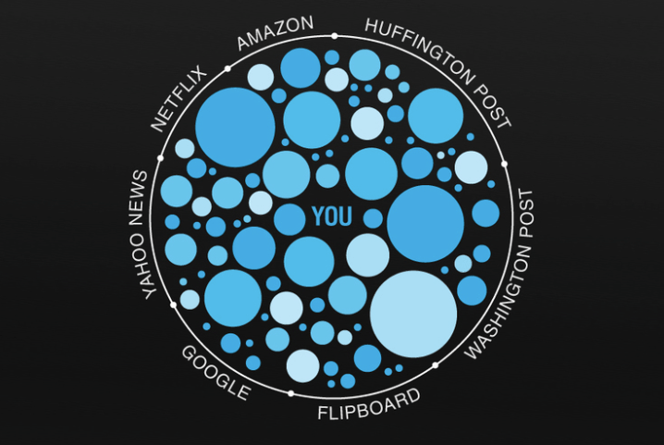
Inadvertent consequences
Discrimination / bias
Filter bubble

Slide 132

Need for summarization
Explosion in amount of text
Image courtesy https://libguides.aecc.ac.uk/copyright/socialmedia

Slide 133



Need for summarization

